Slide 1
Presentation Disclaimer
This presentation is based on preliminary results as of February 9th, 2023 from the Sport and Belonging project. Data analysis is ongoing, and an updated version of the project and results will be published in the future.
We encourage you to check back in with the project at the end of 2023 and in 2024 for published articles and knowledge translation materials.
Please use the following citation:
St.John, L., Renwick, R., Arbour-Nicitopoulos, K., Routledge, F., Zheng, R., Caplan, B., Denault, C., Findlay, F., McDonald, V., & Noronha, J. (2023, Feb). Fostering and developing belonging for young adults with intellectual and developmental disabilities through Sport: Lessons from an inclusive study. Presented at the Canadian Health and Wellbeing in Developmental Disabilities Conference, Toronto, ON.

Slide 2
Fostering and developing belonging for young adults with intellectual and developmental disabilities through Sport: Lessons from an inclusive study
Laura St.John, Rebecca Renwick, Kelly Arbour-Nicitopoulos,
Francis Routledge, Runqun Zheng, Ben Caplan, Callum Denault,
Jennifer Findlay, Victoria McDonald & James Noronha

Slide 3
Acknowledgements
We are grateful for:
Funding provided by the Connaught Foundation
The generosity of participants who shared their experiences and perspectives with us

Slide 4
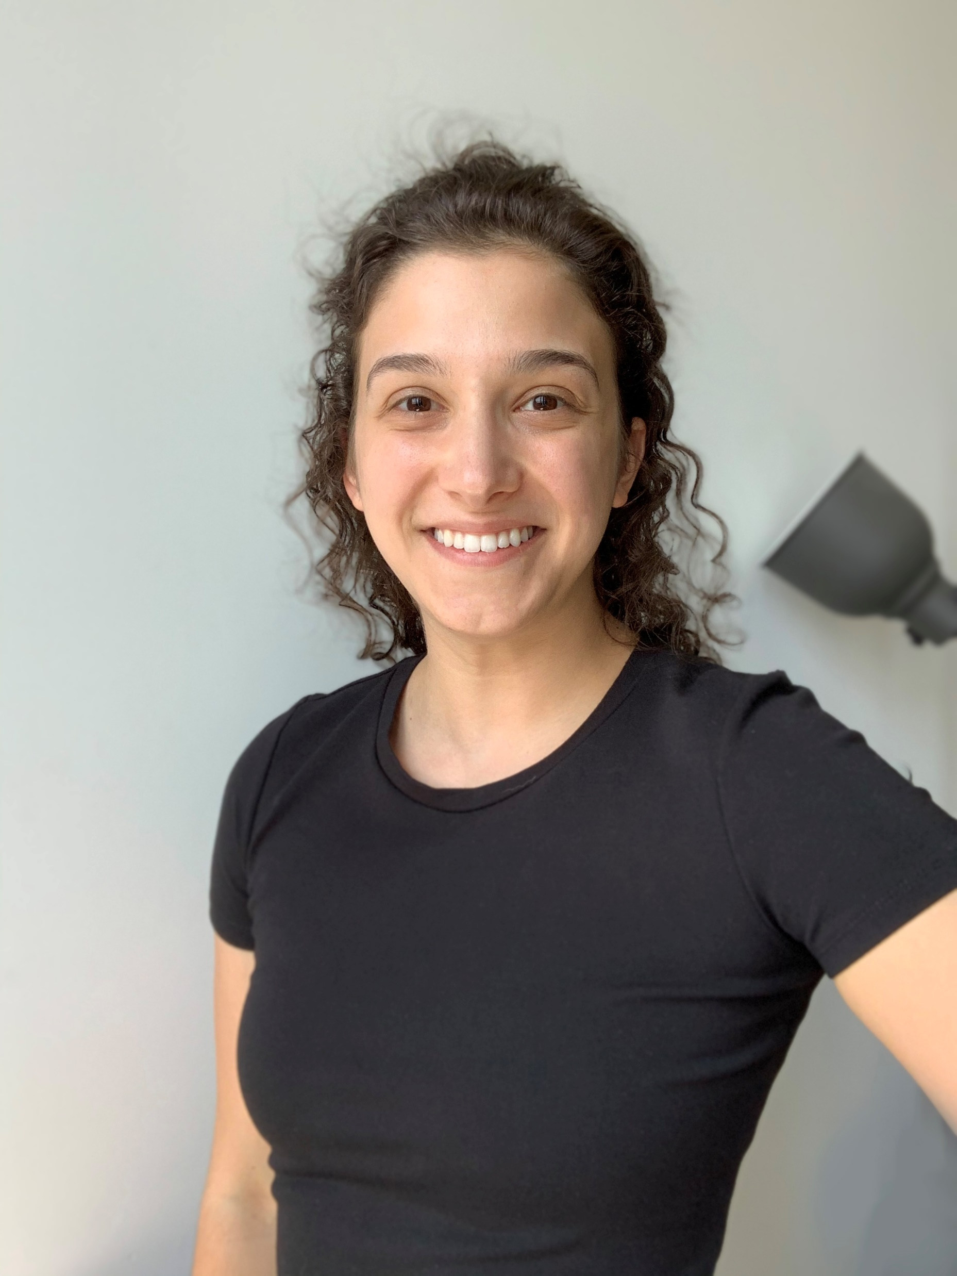
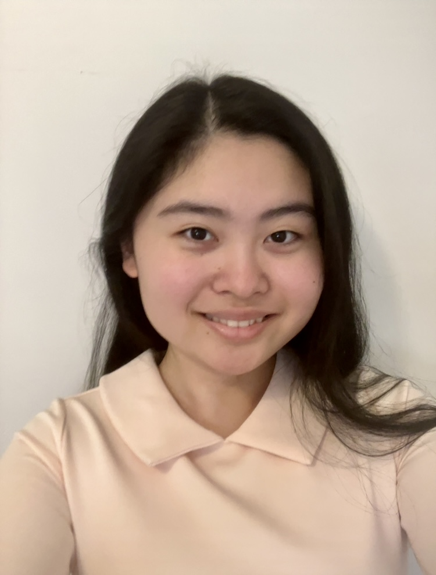
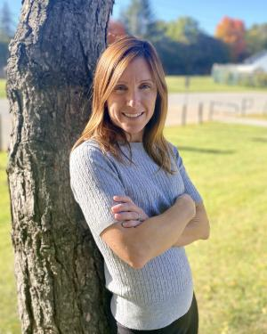
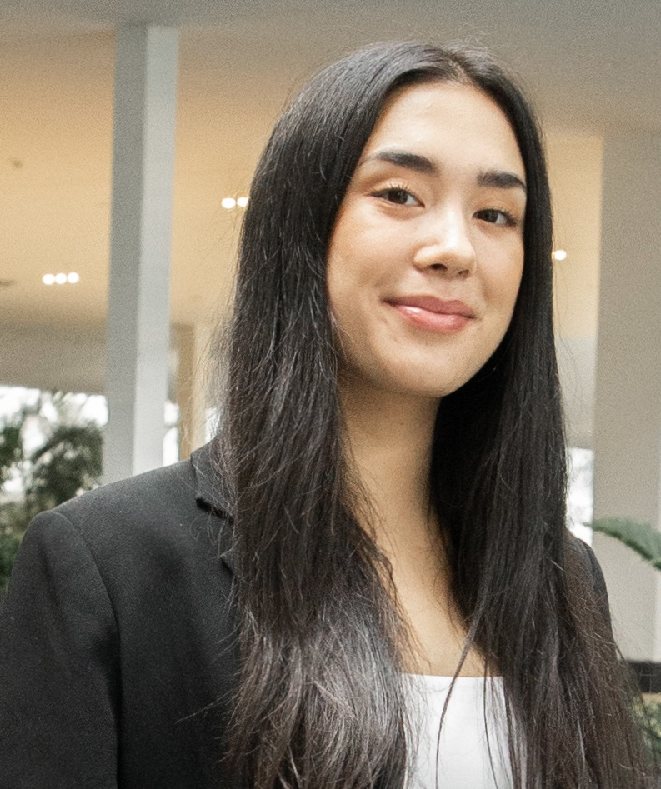
Presenters

Slide 5
Overview
Belonging and the role it has on inclusive practices for individuals with IDD
Highlight our inclusive research project, Sport and Belonging
Introducing our research team and project consultants
Research methods
Member checking process
Preliminary Findings
Implications of inclusive research
Knowledge Translation

Slide 6
What is Belonging

Slide 7
What is belonging?
Comfortable
Part of something
Belonging is experiencing some, or all, of these
Important
You fit in
Included
Safe
Accepted
The Belonging Theoretical Framework (Renwick et al., 2019)

Slide 8
Framework of Belonging

Slide 9
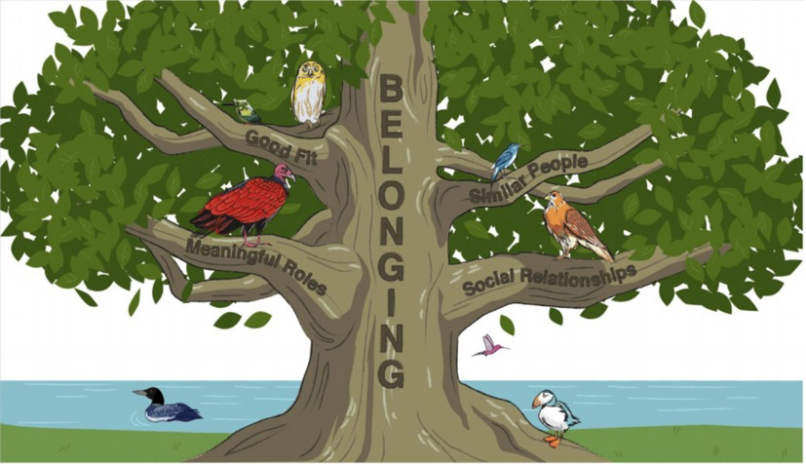
Background
The Belonging Theoretical Framework (Renwick et al., 2019)

Slide 10
Role of organized sport and belonging

Slide 11
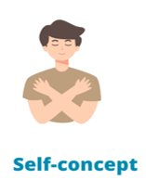
Benefits of Organized Sport
(Arbour-Nicitopoulos et al., 2022; Grandisson et al., 2012; Lloyd et al., 2022; Zhao et al., 2021)

Slide 12
Purpose

Slide 13
Purpose:
Illuminate pathways to belonging (or not) through organized sports participation in Special Olympics for young adults with IDD from their own perspective

Slide 14
Interdisciplinary Team

Slide 15
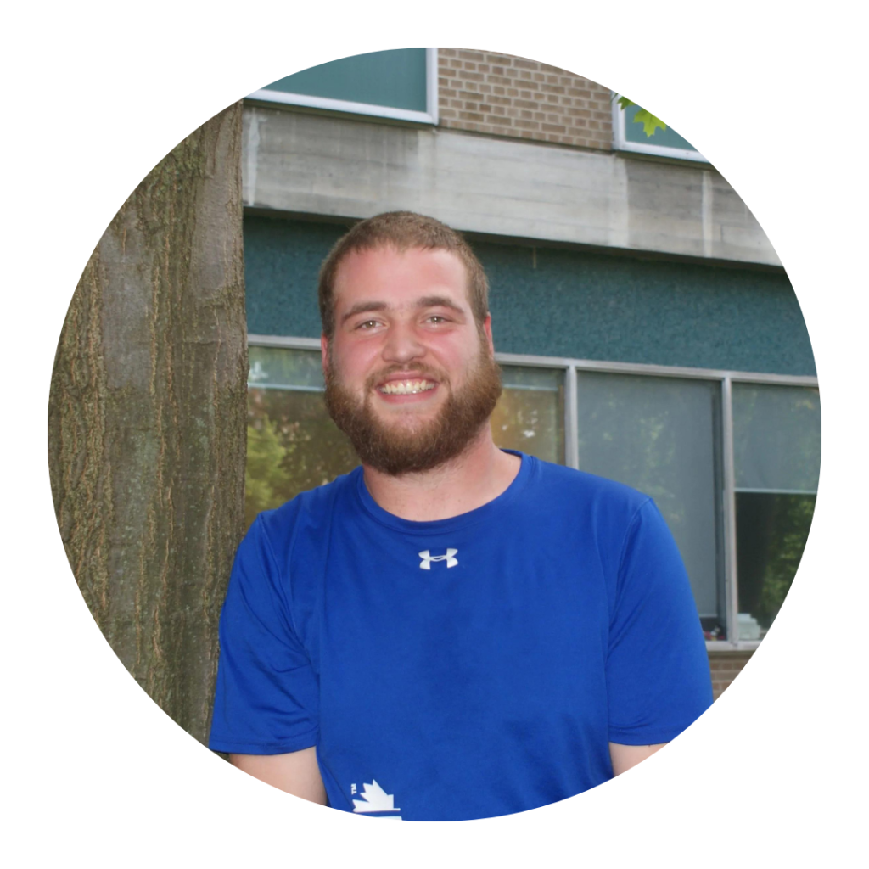
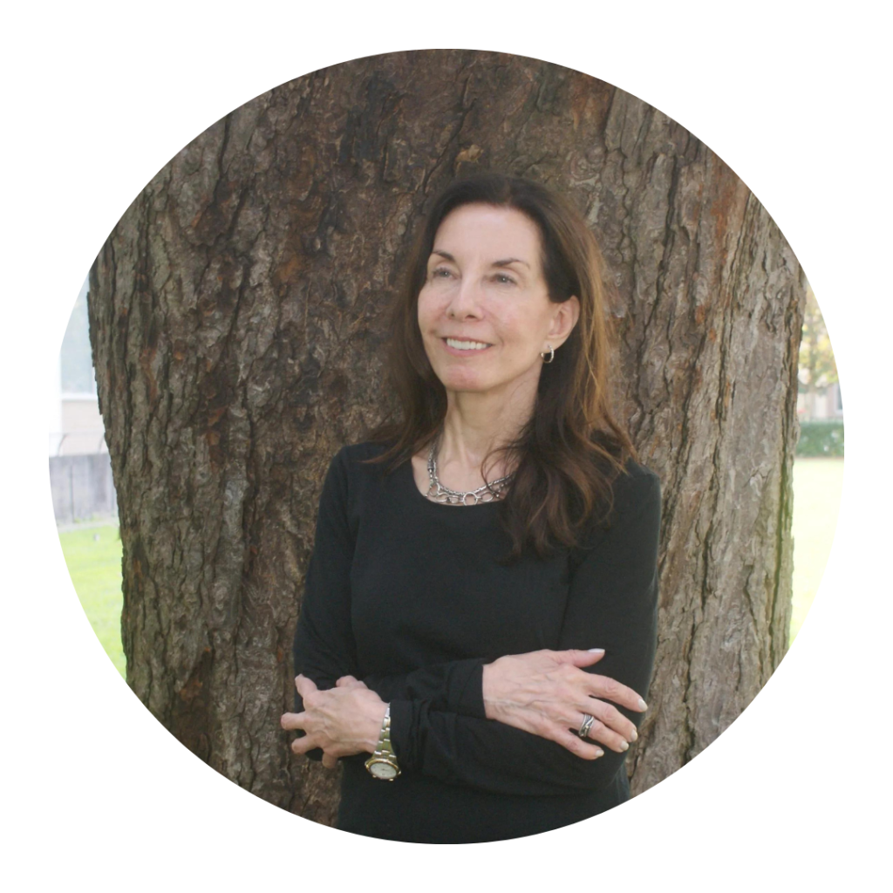
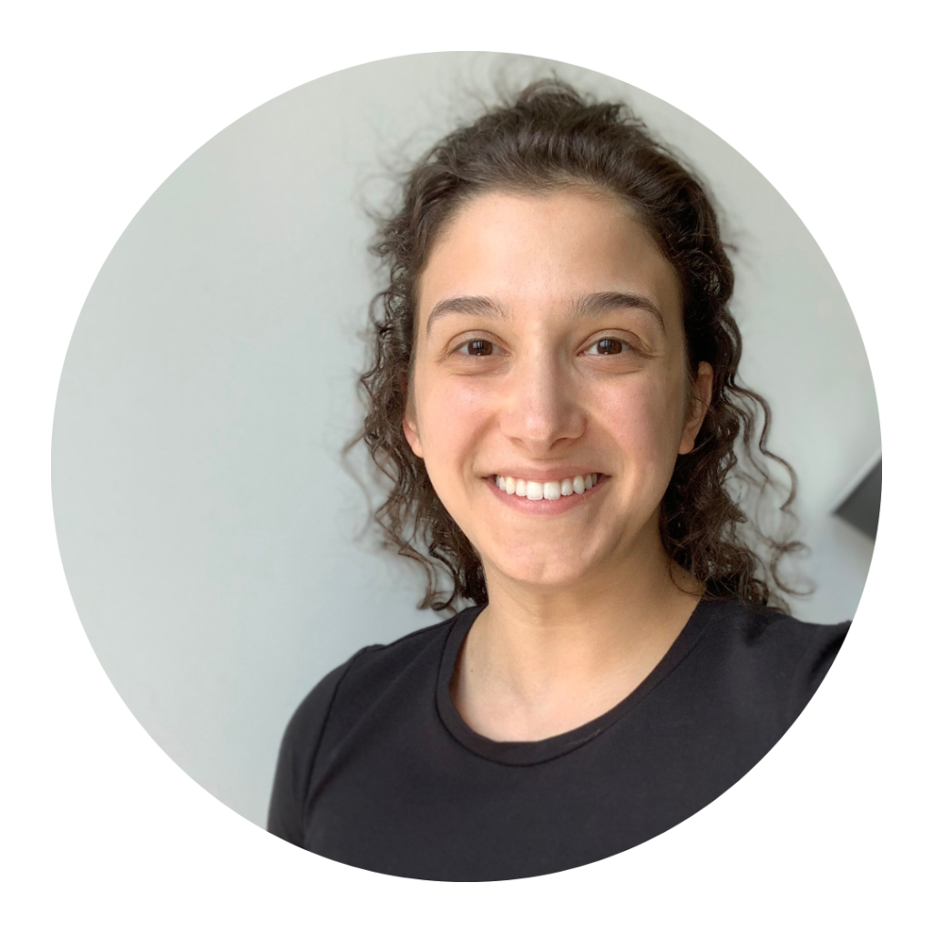
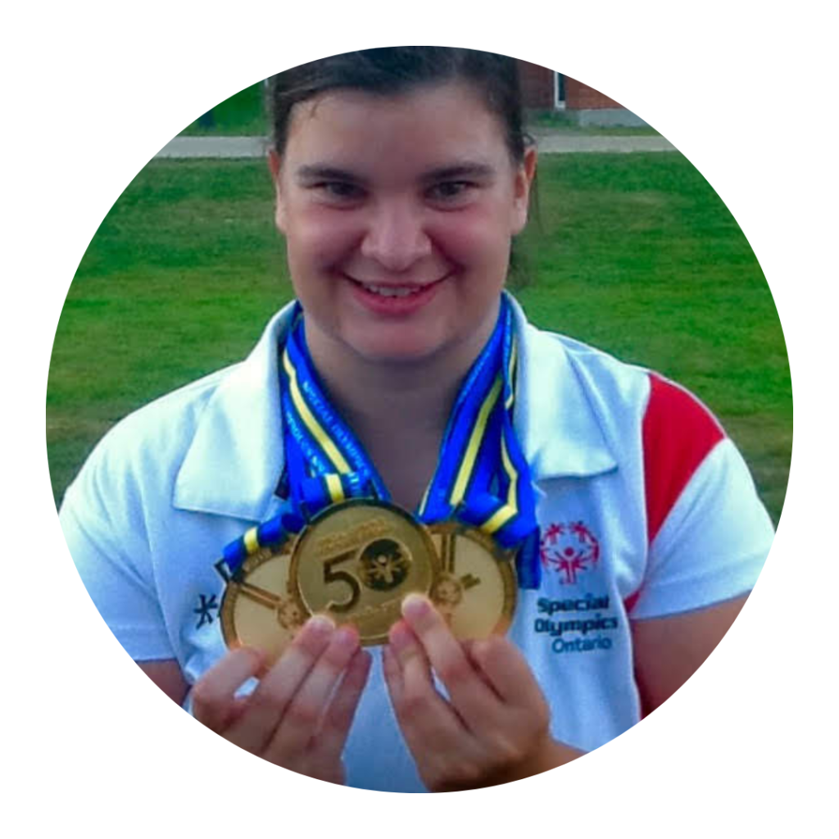
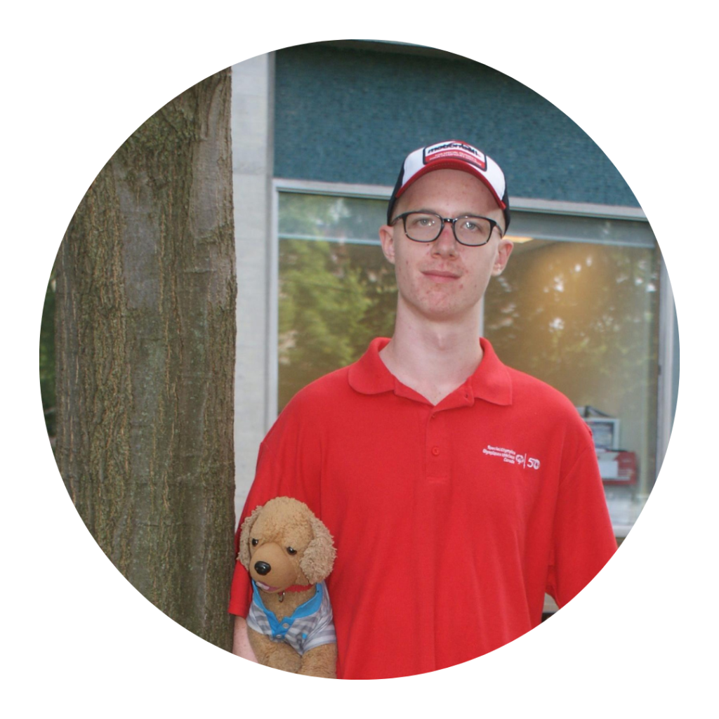
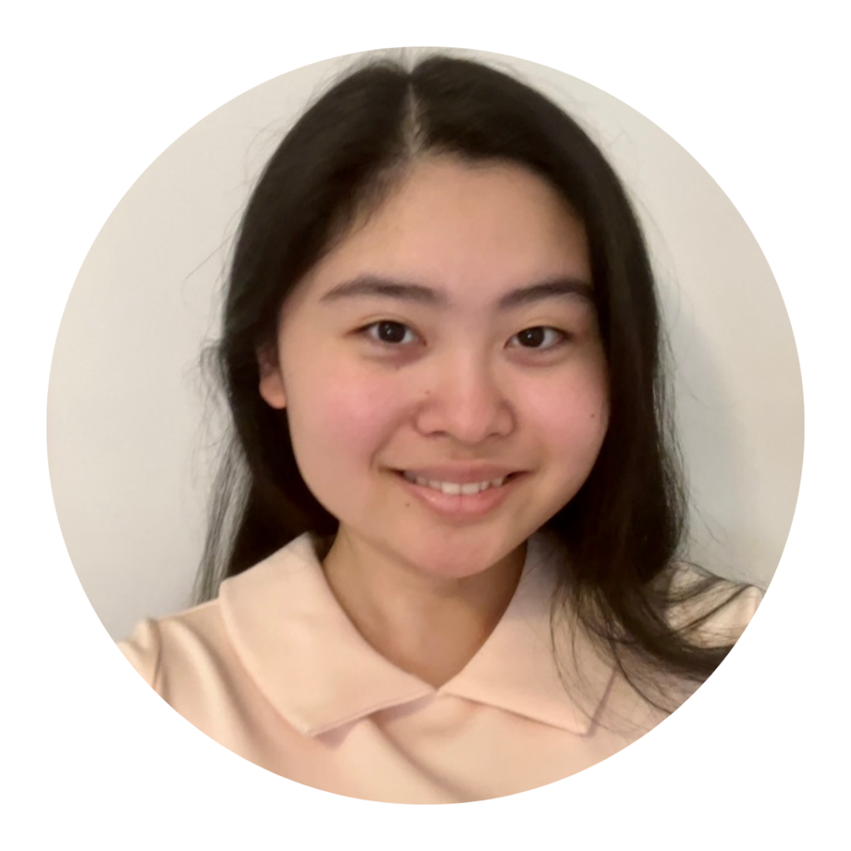

Slide 16
Team members with lived experience

Slide 17
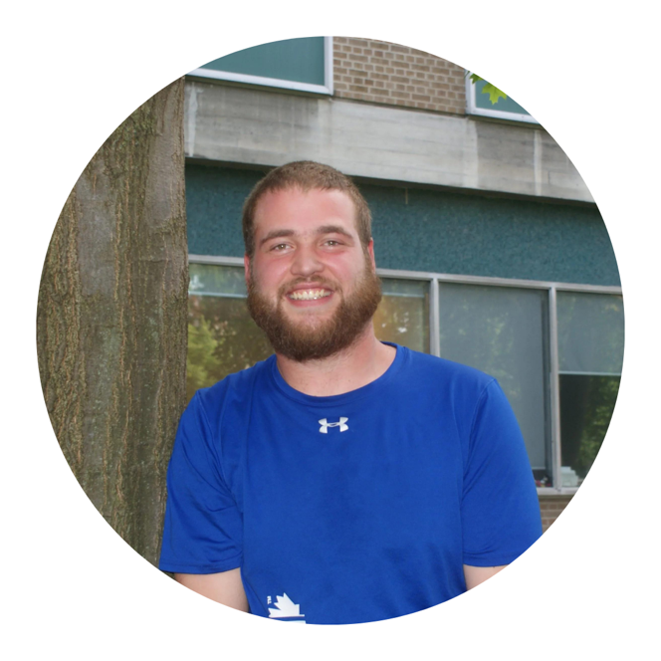
Methods: Our Inclusive Approach
Ben Caplan
Callum Denault
Victoria McDonald
Notes:
​

Slide 18
Contributing Roles of Project Consultants
Project Consultants
Training interviewers
Member Checking
Consent
Feedback on interview guide
Input and contributions which shaped the research process

Slide 19
Project Consultants: In there own words

Slide 20
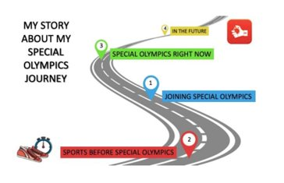
Methods
Participants
10 male and 10 female Special Olympics Ontario athletes
Methods
Narrative Inquiry
Joining Special Olympics | Before Special Olympics | Special Olympics Now | In the Future
Why did you join special Olympics? | Before you start Special Olympics, did you play sports? | What did you do at your last practice or game? | What are your goals in Special Olympics?

Slide 21
Member Checking Video

Slide 22
Member Checking Video
Storyline
Image Design
Narration
Sharing with participants
Asking for feedback

Slide 23
Analysis

Slide 24
Analysis
Thematic analysis of transcribed interview data
Several analysts
Analysts meet regularly to discuss and refine emerging themes and sub-themes
Now in final stages of refining themes and sub-themes

Slide 25
Results
Emerging Themes
Support From Allies when Participating in Sports
Opportunities to Discover and Develop Own Interests

Slide 26
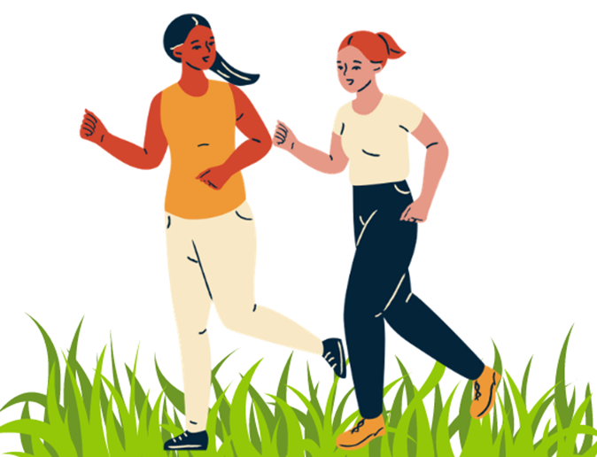
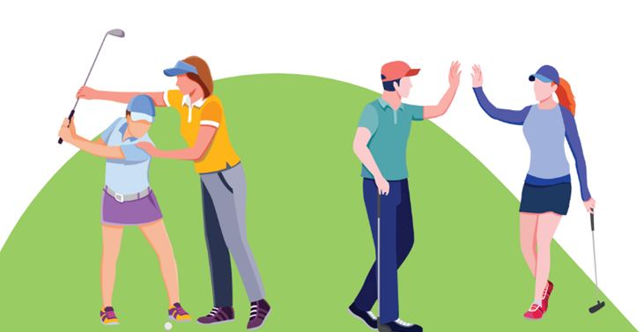
Theme 1: Support From Allies when Participating in Sports
A) Allies motivate athletes to make connections in Special Olympics
B) Allies motivate athletes by rooting for them at practices and games, and by supporting their team through volunteerism
C) Allies support athletes’ development of interest in sport by encouraging physical activity.

Slide 27
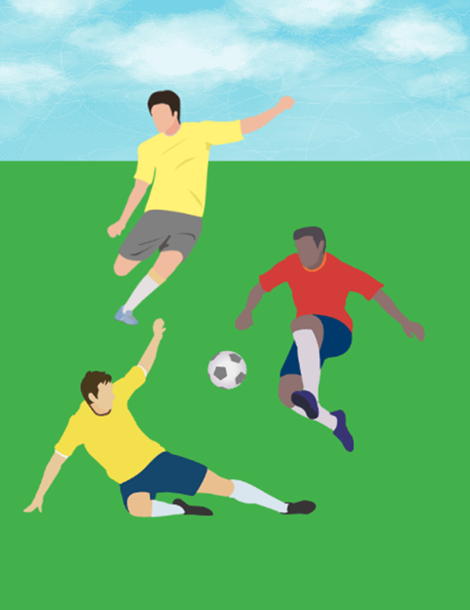
Theme 2: Opportunities to Discover and Develop Own Interests
A) Having an inclusive place to pursue passions
B) Opportunities for positive feedback and constructive criticism from coaches to strengthen their skillset

Slide 28
Implications of Inclusive Research

Slide 29
Implications of Inclusive Research
VALUE TO THE RESEARCH
Helps to ground research in lived experiences
Ensures the findings are relevant to the population
VALUE TO THE COMMUNITY
Knowledge Translation
Accessibility of KT, who is it for, what type of media we can use
VALUE TO THE PROJECT CONSULTANT
Opportunities to enhance current interpersonal skills, develop research-related skills and learn new skills
Contribute to shaping the direction and process of research that is relevant to their lives and the lives of their peers

Slide 30
The Belonging Theoretical Framework (Renwick et al., 2019)

Slide 31
Knowledge translation initiatives

Slide 32
For more information, visit our website:
https://www.sportandbelonging.ca
Thank you!

Slide 33
References
Arbour-Nicitopoulos, K. P., Kuzik, N., Vanderloo, L. M., Martin Ginis, K. A., James, M. E., Bassett-Gunter, R. L., Ruttle, D., DaSilva, P., Disimino, K., Cameron, C., Arthur, M., Shikako, K., & Latimer-Cheung, A. E. (2022). Expert Appraisal of the 2022 Canadian Para Report Card on Physical Activity for Children and Adolescents With Disabilities, Adapted Physical Activity Quarterly
Grandisson, M., Tétreault, S. and Freeman, A.R. (2012), Enabling Integration in Sports for Adolescents with Intellectual Disabilities. Journal of Applied Research in Intellectual Disabilities, 25: 217-230.
Lloyd M, Temple VA, Foley JT, Yeatman S, Lunsky Y, Huang A, Balogh R. Young adults with intellectual and developmental disabilities who participate in Special Olympics are less likely to be diagnosed with depression. Soc Psychiatry Psychiatr Epidemiol. 2022 Dec 22.
Renwick, R., DuBois, D., Cowen, J., Cameron, D., Fudge Schormans, A., & Rose, N. (2019). Voices of youths on engagement in community life: a theoretical framework of belonging. Disability & Society, 34(6), 945–971. https://doi.org/10.1080/09687599.2019.1583551
Zhao, WM, Thirumal, K, Renwick, R, DuBois, D. Belonging through sport participation for young adults with intellectual and developmental disabilities: A scoping review. J Appl Res Intellect Disabil. 2021; 34: 402– 420.

Slide 34
Presentation Disclaimer
This presentation is based on preliminary results as of February 9th, 2023 from the Sport and Belonging project. Data analysis is ongoing, and an updated version of the project and results will be published in the future.
We encourage you to check back in with the project at the end of 2023 and in 2024 for published articles and knowledge translation materials.
Please use the following citation:
St.John, L., Renwick, R., Arbour-Nicitopoulos, K., Routledge, F., Zheng, R., Caplan, B., Denault, C., Findlay, F., McDonald, V., & Noronha, J. (2023, Feb). Fostering and developing belonging for young adults with intellectual and developmental disabilities through Sport: Lessons from an inclusive study. Presented at the Canadian Health and Wellbeing in Developmental Disabilities Conference, Toronto, ON.

